Slide 1
Real and Fake News
Sara Satti
Data Science Career Track

Slide 2
Objective
Build a model to distinguish whether an article is Real or Fake

Slide 3
Outline
Data Wrangling
Exploring the Data
WordClouds
Statistical Analysis
Machine Learning
Model Comparisons
Stress tests
Conclusions
Recommendations

Slide 4
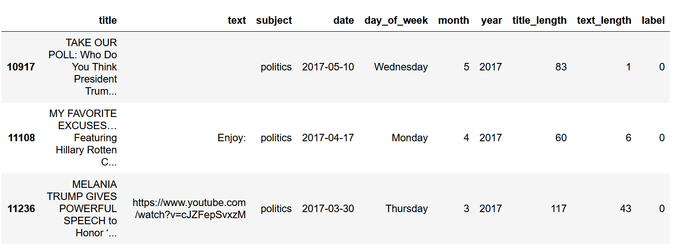
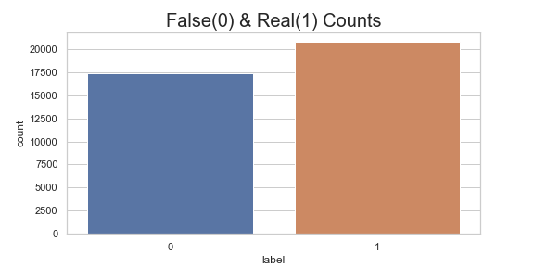
Data Wrangling
Load Fake / Real data
Remove ‘http’ entries
Drop rows with duplicate entries
Feature engineering:
date,
title_length
text_length
Label and combine Fake and Real datasets
54.5%
45.5%
Notes:
Fake and real data came in separate files...had to label them before combining into one file.

Slide 5
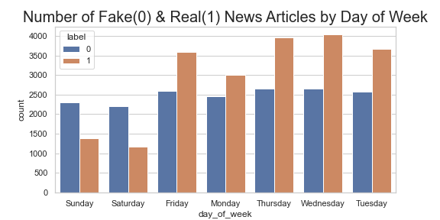
Exploring the Data - Fake news knows no rest!
Fake news - Uniform distribution
Real news -
Peaks mid-week
60% drop in number of articles over the weekend.
Notes:
Fake news uniform throughout the week/Real news mostly on weekdays.

Slide 6
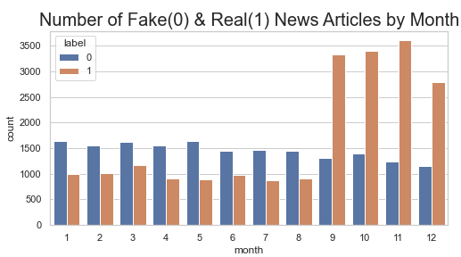
Exploring the Data
Fake news -
Uniform distribution
Jan-August at higher count than real news
Real news -
At 1000 articles Jan-August
Jump to >3X Sept to Dec
Notes:
Real news mostly in Sept to Dec timeframe - around election and inauguration time?
Suggests feature can be engineered to represent Q4 or 9-12.

Slide 7
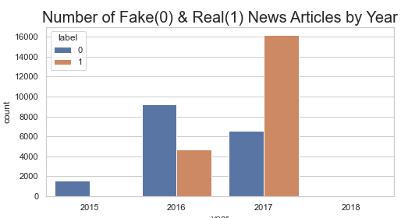
Exploring the Data - Election year:
Fake news - 2015 - 2017
Real news - 2016 - 2017
Notes:
Real news in dataset for 2016 and 2017/Fake news for 2015/16 and 17

Slide 8
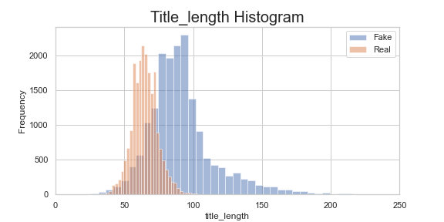
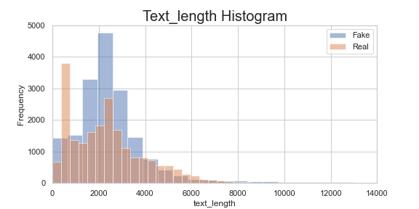
Exploring the Data - Text / Title-length
Title-length:
Fake news -
Mean: 91
Few titles >150 characters
Real news
Mean: 65
Normally distributed
Text-length: fake and real news overlap
Notes:
Text-length: overlap with mean text length of 2368, std 1666. max:29,781(real), and min=1+whitespace...will have to be cleaned.
Text_length(fake): mean:2550, std:2199, max 51794 and min:1
Title-length(fake): mean91, std 24.5, min15:, max:286
Title-length(real): mean:65, std:9 , min:26, max:133

Slide 9
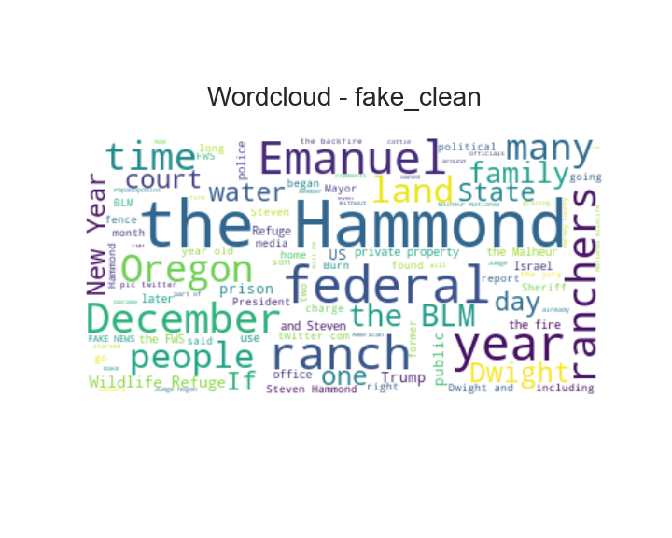
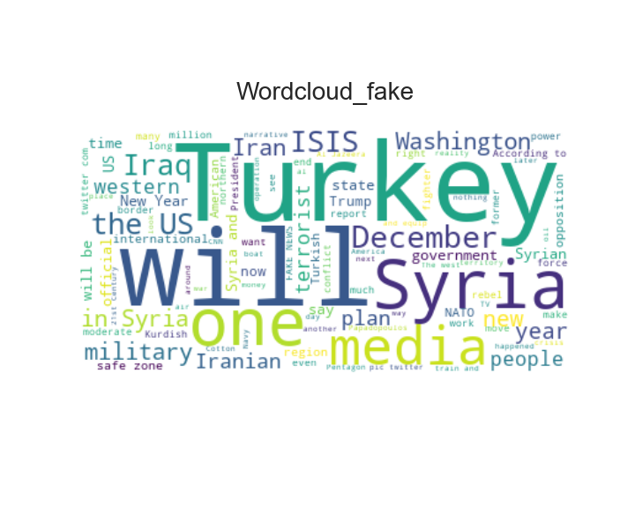
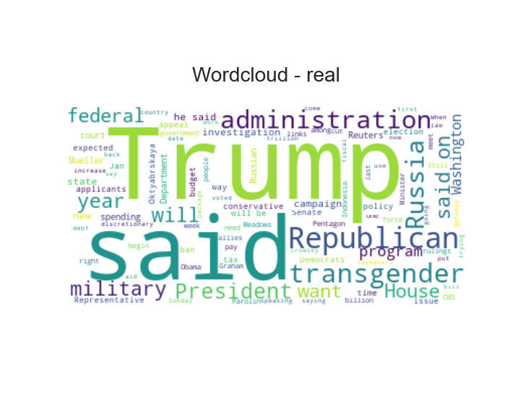
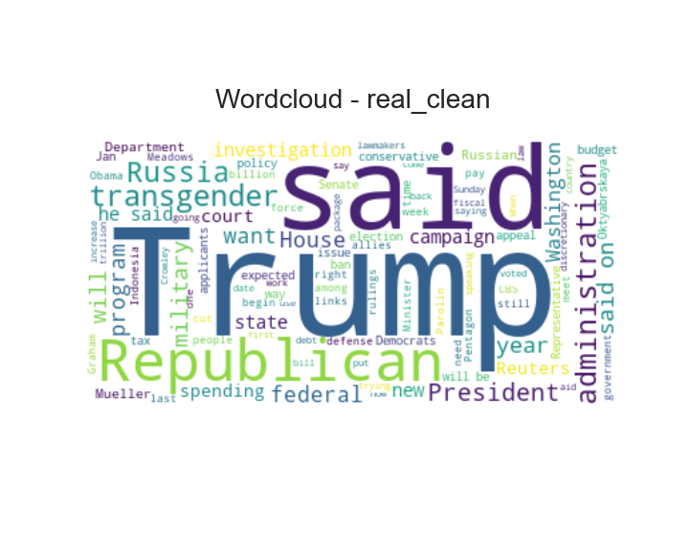
Exploring the Data
Delete urls
Drop duplicate rows
Drop row (text < 45)
Drop duplicate rows
Notes:
Top 100 words in each category.
128 rows dropped that had text length less than 45...mostly https links to videos, images or whitespace...Turkey/Syria etc. appear mostly is video or http related ‘text’?
Some words e.g. Trump/federal/President shows up in BOTH categories.
TURKEY/SYRIA/ISIS disappear after cleaning...mostly linked to https and videos?

Slide 10
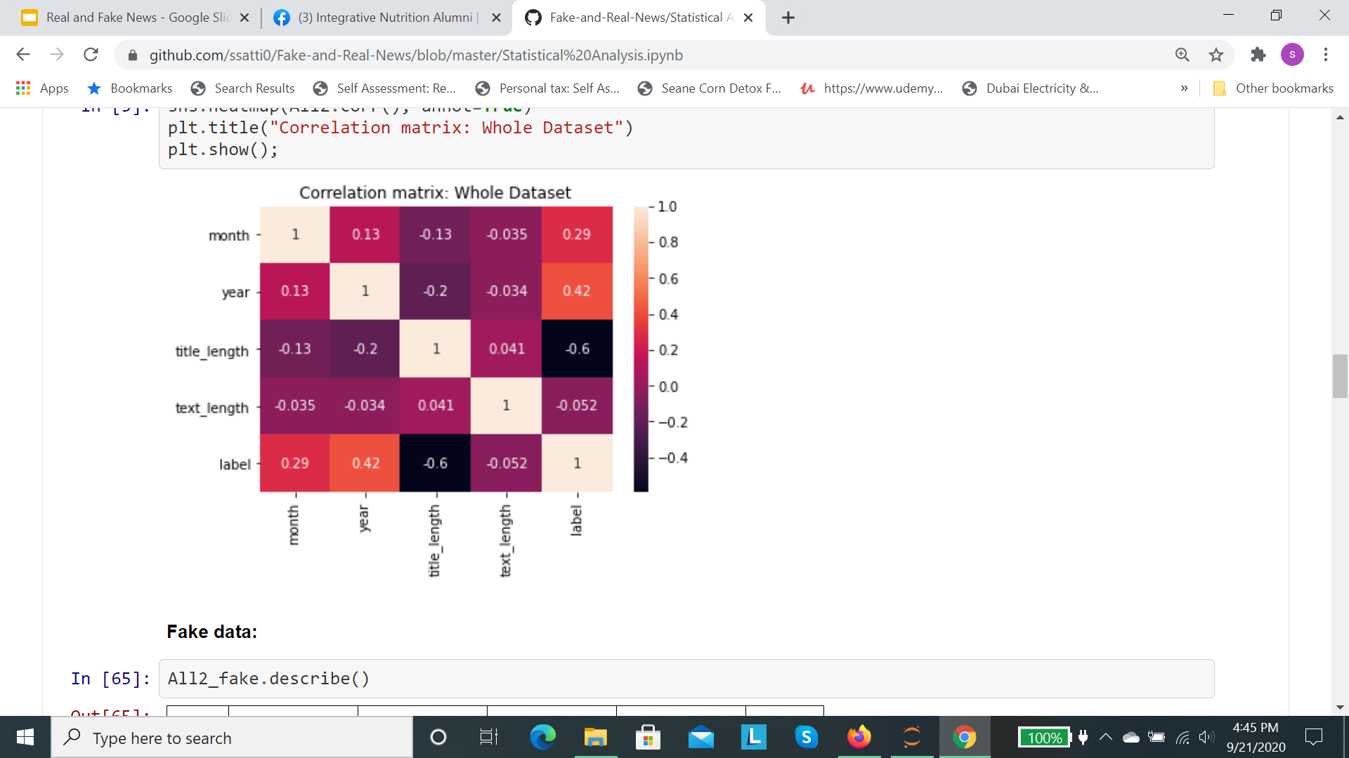
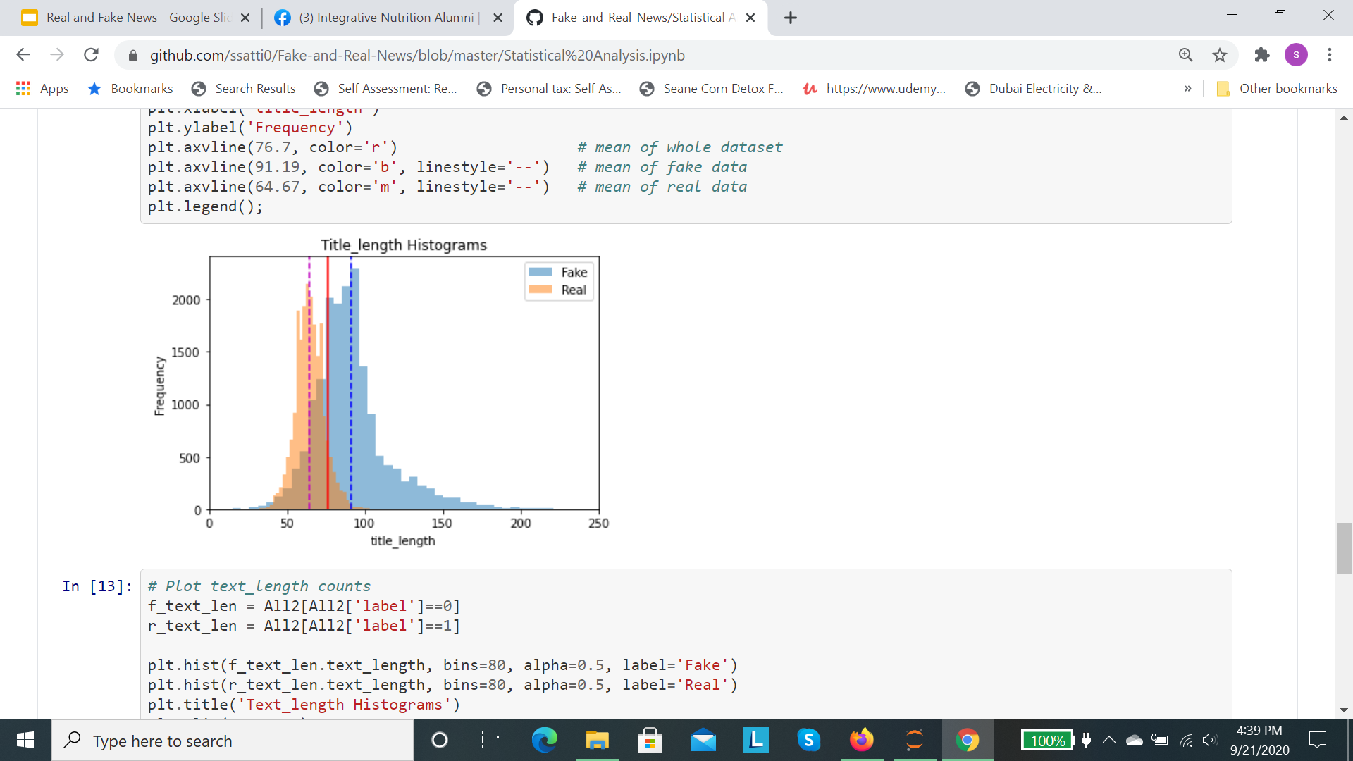
Statistical Analysis
Samples are independent (pearson’s cor coef = 0.006)
T-statistic of 133, p-value=0 => probably different distributions.
Highest correlation - title_length/label
Label has lowest correlation to text_length
Positive corr with month/year - reflected in barcharts
Notes:
Highest negative correlation with title_length: longer titles tend to be fake news.
Broken lines are means of each dataset… solid line is mean of the whole data set.
T-statistic of 0 means sample results and null hypothesis are exactly equal, but greather numbers means they differ more significantly.
Null hypothesis: no difference in mean of title-lengths of the fake and real distributions.

Slide 11
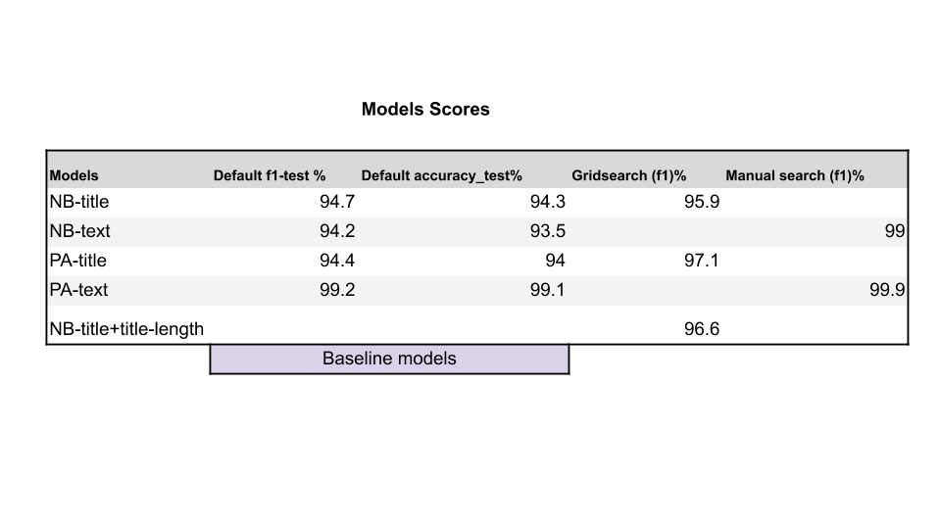
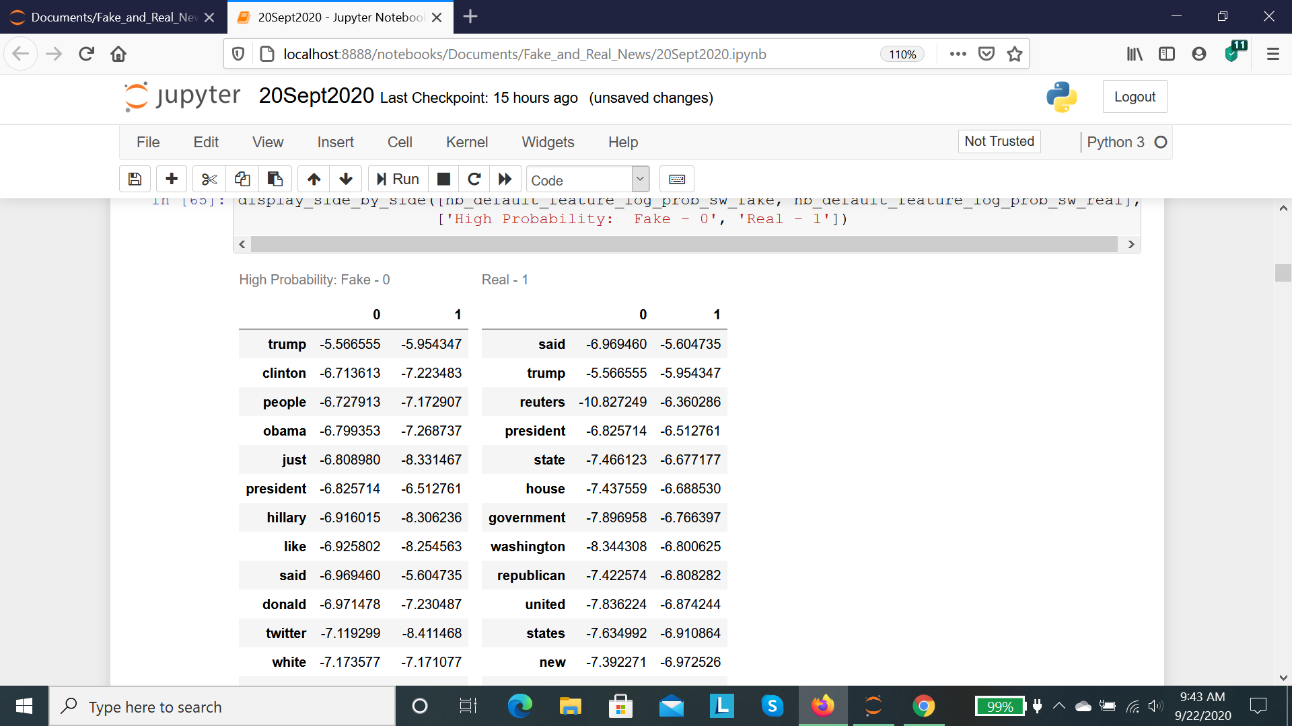
Machine Learning
Models (‘text’) - better scores.
Model using title and title_length - slightly improved f1 score (95.9 to 96.6%).
Decreasing Prob
Notes:
Table is the log-probability from running NB model. Shows the likelihood of the article being real or fake when certain words show up.
Red column: high probability FAKE words, sorted in descending order.
Green column: high probability REAL words, sorted in descending order. High negative ⇒ low probability
trump/president show up in both fake and real news.
Twitter: fake, Reuters:real.

Slide 12
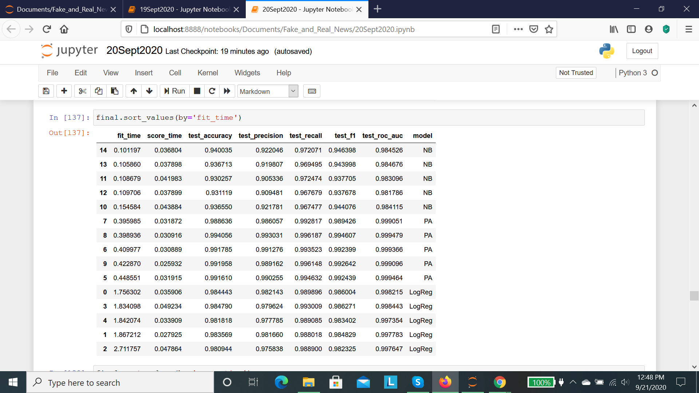
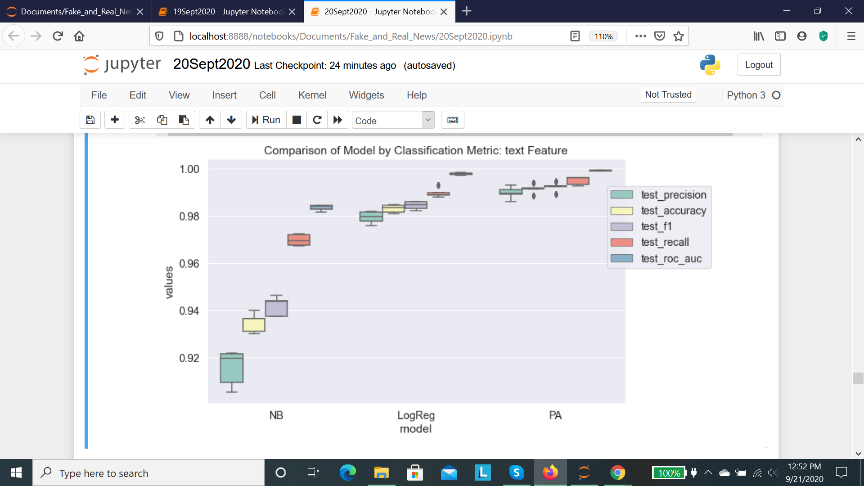
Model Comparisons
NB - lowest training time.
PA - highest f1 score.
Logistic Regression - slowest in training.
Notes:
Table sorted by training time: NB best, and Logreg ‘worst’.

Slide 13
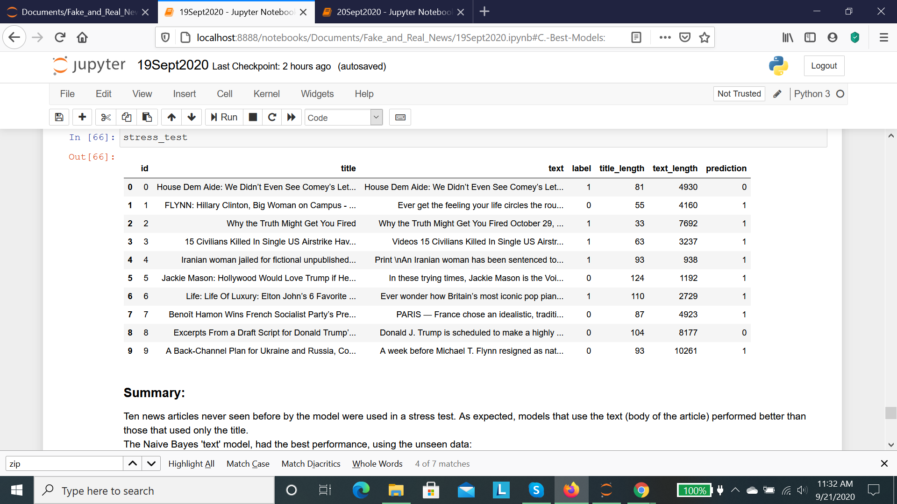
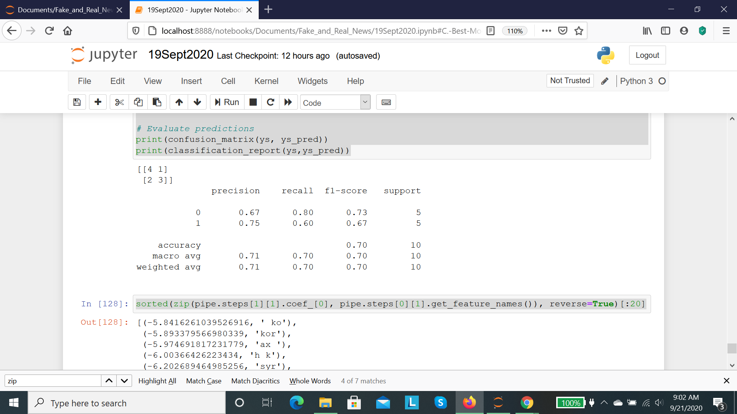
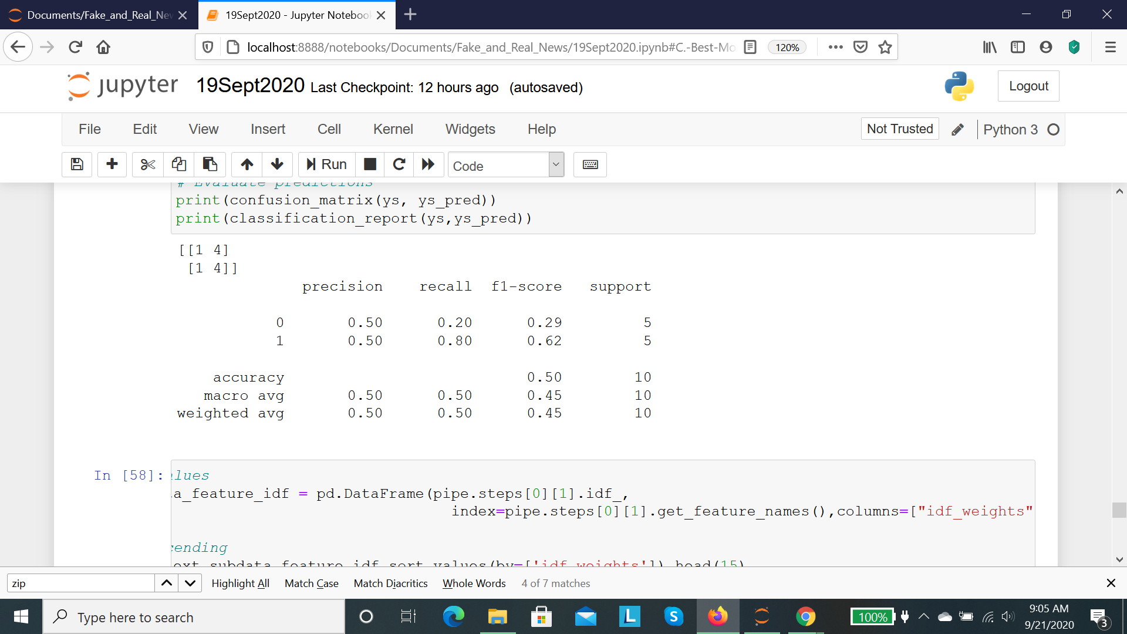
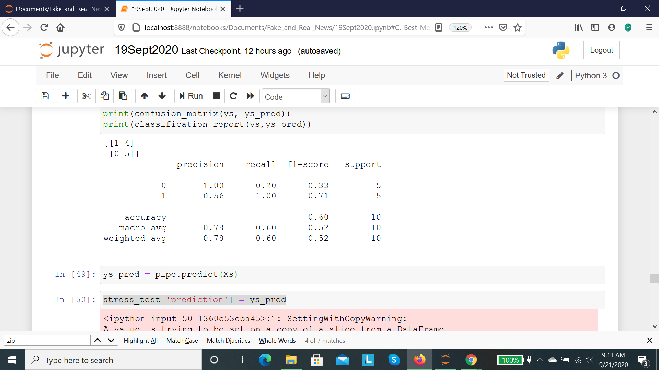
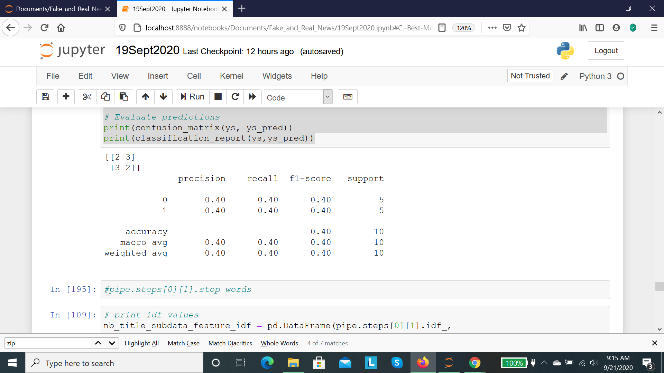
Stress Tests
NB-text : alphabetics only
C) PA-text
NB-text
B) NB-title
Notes:
Randomly selected 10 articles from a different kaggle dataset, for stress-test.
Depending on model and feature used accuracy from 40-60%.
Better results with ‘text’ than ‘title’.
Removing of characters, numbers and symbols from ‘text’ resulted in a big jump in accuracy, AND better predictions of Fake news whle drop in prediction of Real is minimal.

Slide 14
Conclusions
Supervised learning worked well in predicting whether a news article is Real or Fake from within the same kaggle dataset. However, when introducing articles from other datasets, the performance was considerably lower. Removal of characters, numbers and symbols from the body of the news article considerably improved the performance of the models. Maximum improvement was seen in the Naive Bayes model where accuracy increased by 10% (from 60% to 70%), Fake news f1-score increased by 40%(from 33-73%), and f1-score for Real news dropped by 4% (71-67%).
Numerical, categorical and datetime features were skipped in order to focus on Natural Language features.
Title_length of the Fake and Real data showed a separation between their means. A multi-feature model using 'title' and 'title_length' was tested. This model led to a slight improvement in the performance (from f1:95.9 to 96.6%) when compared to the 'title' only model.

Slide 15
Recommendations
Combine features from title, and text and perhaps title_length to produce a model containing these and any other numerical features extracted from the data.
More complex methods such as neural networks to be tested in the future in order to further generalize the model.

